Slide 1

Maternal smoking during pregnancy and adult offspring’s wages
Milja Kivelä, Iiro Nerg, Marko Korhonen, Ina Rissanen
Julius Center for Health Sciences and Primary Care, University Medical Center Utrecht, The Netherlands
Research Unit of Population Health, Medical Faculty, University of Oulu
Oulu Business School, Department of Economics, University of Oulu

Slide 2


Introduction
Smoking during pregnancy is a risk factor for:
Adverse pregnancy outcomes
Poor health of the offspring later in life
We hypothesize that it could affect the offspring’s life in ways that lead to a lower wage.

Slide 3
Research questions
Is there an association between maternal smoking during pregnancy and wages in adult offspring?
If yes, what are the mediation pathways?
Poor perinatal conditions
Sociodemographics
Poor health
Own smoking

Slide 4
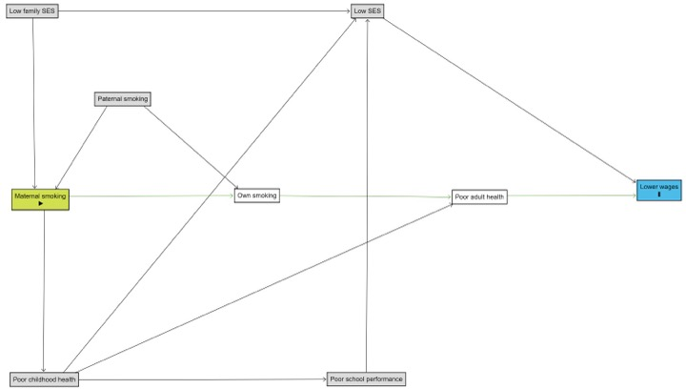

Slide 5


Northern Finland Birth Cohort 1966
Birth cohort of 12,058 live-born children and their mothers
Current sample = 11,566 offspring
Followed up with questionnaires, clinical examinations and registers since 2nd trimester of pregnancy

Slide 6


Methods
Maternal smoking during pregnancy
Collected prospectively with questionnaire
Of mothers, 2230 (19.3%) smoked after 2nd month of pregnancy

Slide 7
Methods
Offspring’s wage
Between ages 29 to 50 years
Finnish Tax Administration registers
Self-employed workers, farmers, and retired persons excluded

Slide 8
Methods
Mediators:
Poor perinatal conditions Birth weight
Sociodemographics Education
Poor health Self-reported health in adulthood
Own smoking habits in adulthood

Slide 9



Methods
Logistic regression models
Mediating effects were tested using the method suggested by Iacobucci 2012
Analyses stratified by sex

Slide 10
Results
Smoking during pregnancy associated with the offspring’s lower wages
Smoking during pregnancy associated with the offspring’s own smoking
Lowest wages were seen in the group whose mothers had smoked during pregnancy and who also smoked themselves as adults

Slide 11
Results
The effect of maternal smoking on wage was mediated through:
Education for both sexes
Poor adult health for males
Own smoking for females

Slide 12
Conclusion
We found a direct effect of maternal smoking in utero on the development of future wages of the offspring
The effect is mediated through the offspring’s education, adult health, and smoking status.

